Slide 1
Polling Device Development Project
Prototype Presentation
Metropolia University & Hochschule Osnabrück University 13.2.2024

Slide 2
Contents
Overview
Frontend Development
Electronics Design
ESP Programming
Server Programming
Hardware Development

Slide 3
Overview
The international Sensor Development Course aims to develop a microcontroller based wireless polling device and a back end system together with students from Metropolia University and Hochschule Osnabrück.
Original Project Goals
A working server (raspberry pi) that collects votes and serves a website to guide voting device registration and final vote tally.
The system shall support anonymous and registered voting.
The system shall be as self explanatory and simple to use as possible.
The voting device shall be as power efficient as possible.
Scalable (The voting remotes shall be plug and play)

Slide 4
FRONTEND DEVELOPMENT
Team: Andrea, Jeferson, Adrian
Device registration management
Creating vote topics
Displaying vote results

Slide 5

Retrieving, sending and displaying data
Fetching data:
GET request to API endpoints
Handling JSON response from API server
Parsing received data into HTML elements
Posting data:
POST request to API endpoint
Handling response from API server (success or fail)

Slide 6
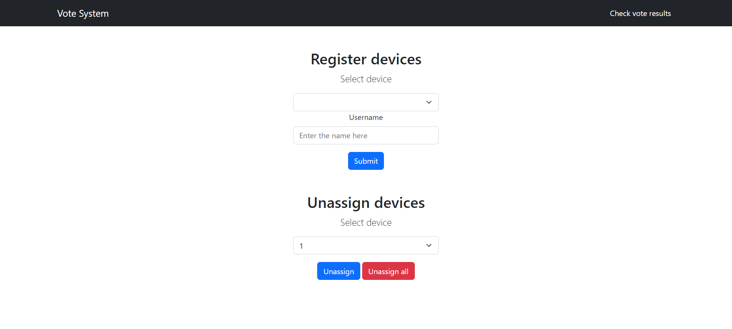
Device registration page
Register devices with username
Unassign selected device
Unassign all devices
Navigate to Votes page

Slide 7
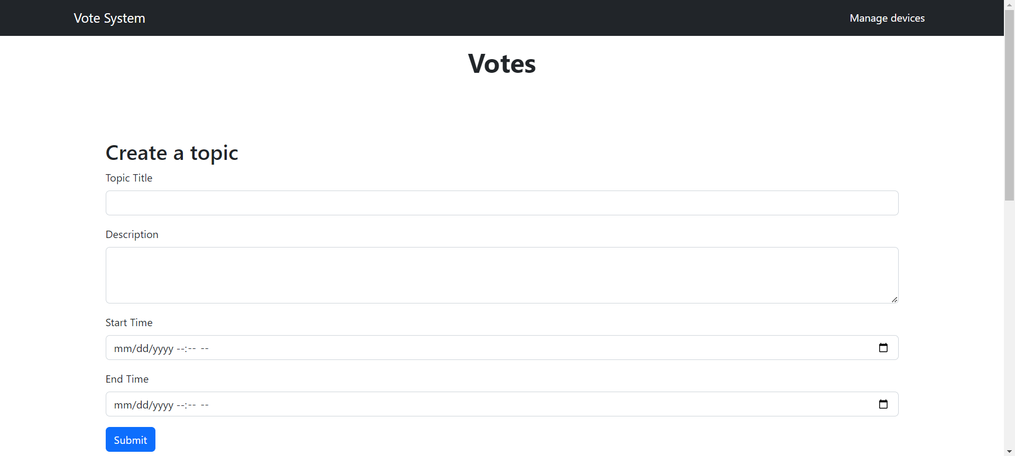
Votes page
Creating vote topics
Topic details:
Title
Description
Start/End time

Slide 8
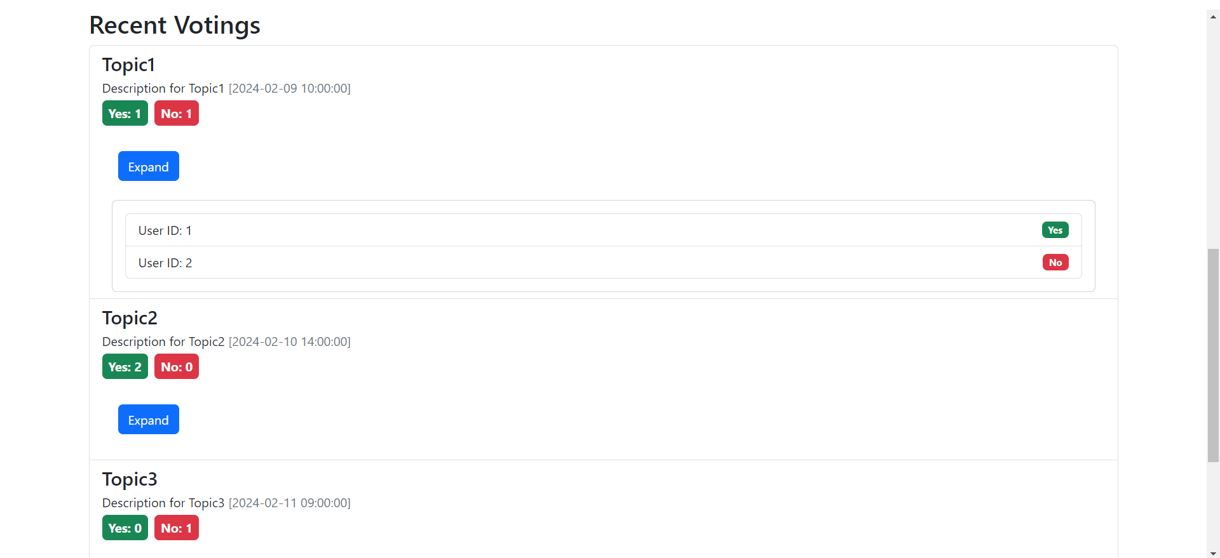
Votes page
Vote results
Displaying results by latest topics
Vote timestamp
Vote results
Expand: show votes by users

Slide 9
ELECTRONICS DESIGN
Team: Mong, Tuomas
Schematic
PCB
Connections

Slide 10
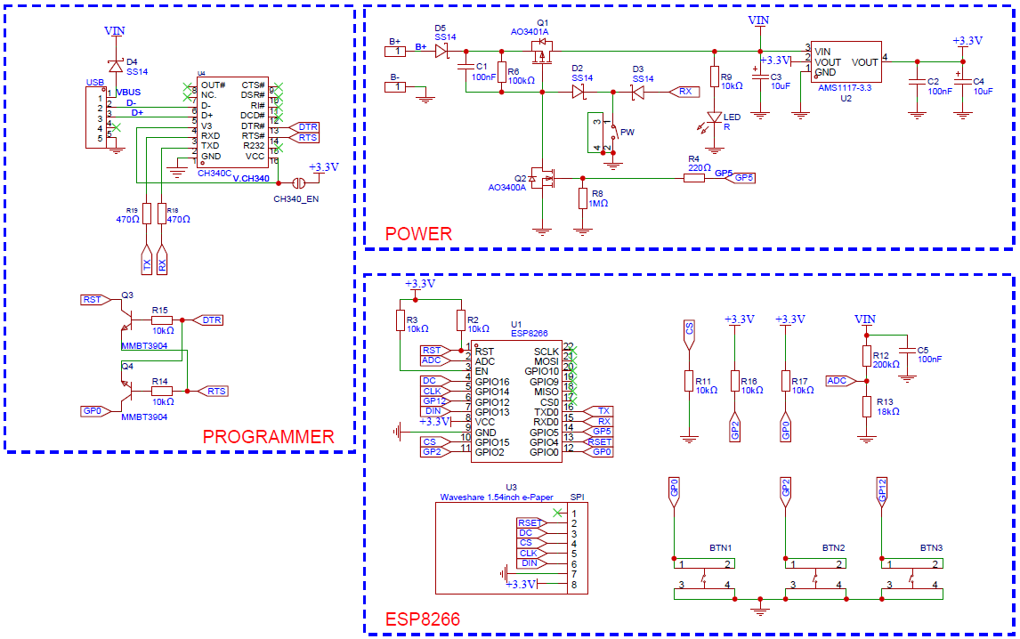
Schematic

Slide 11
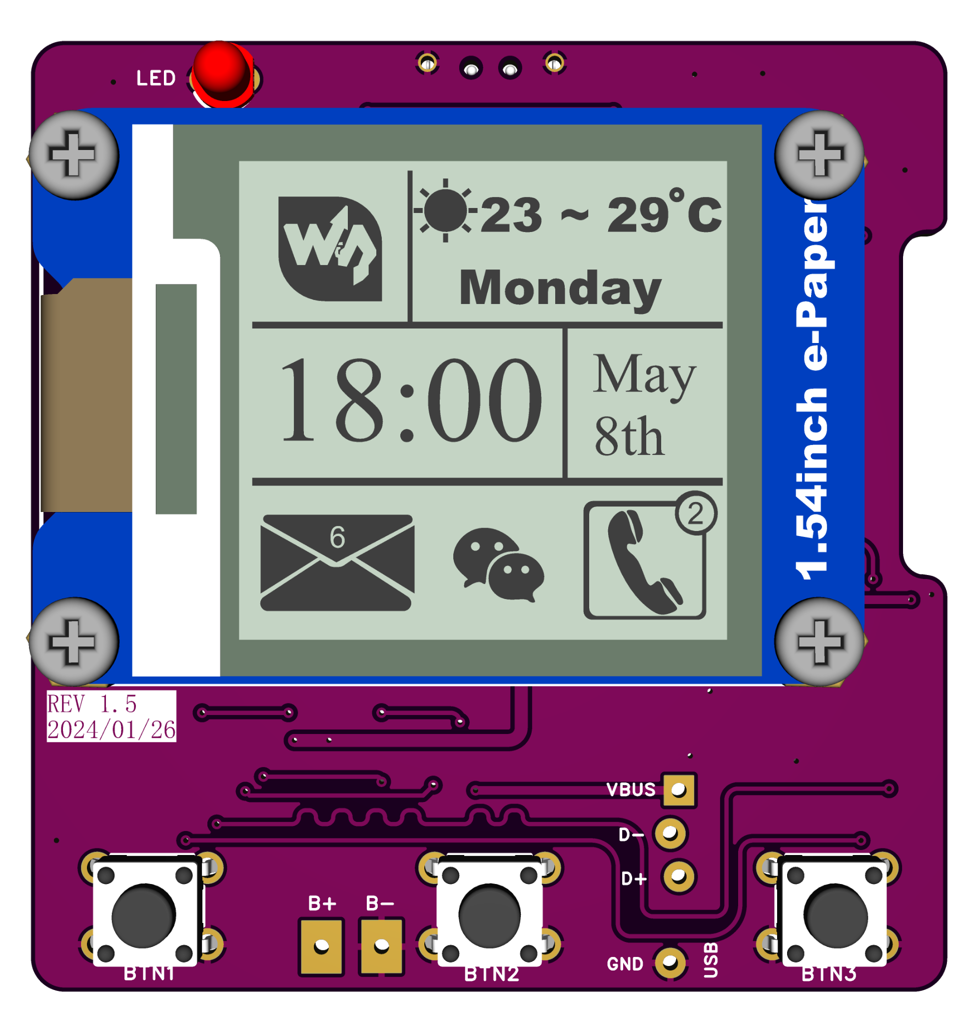
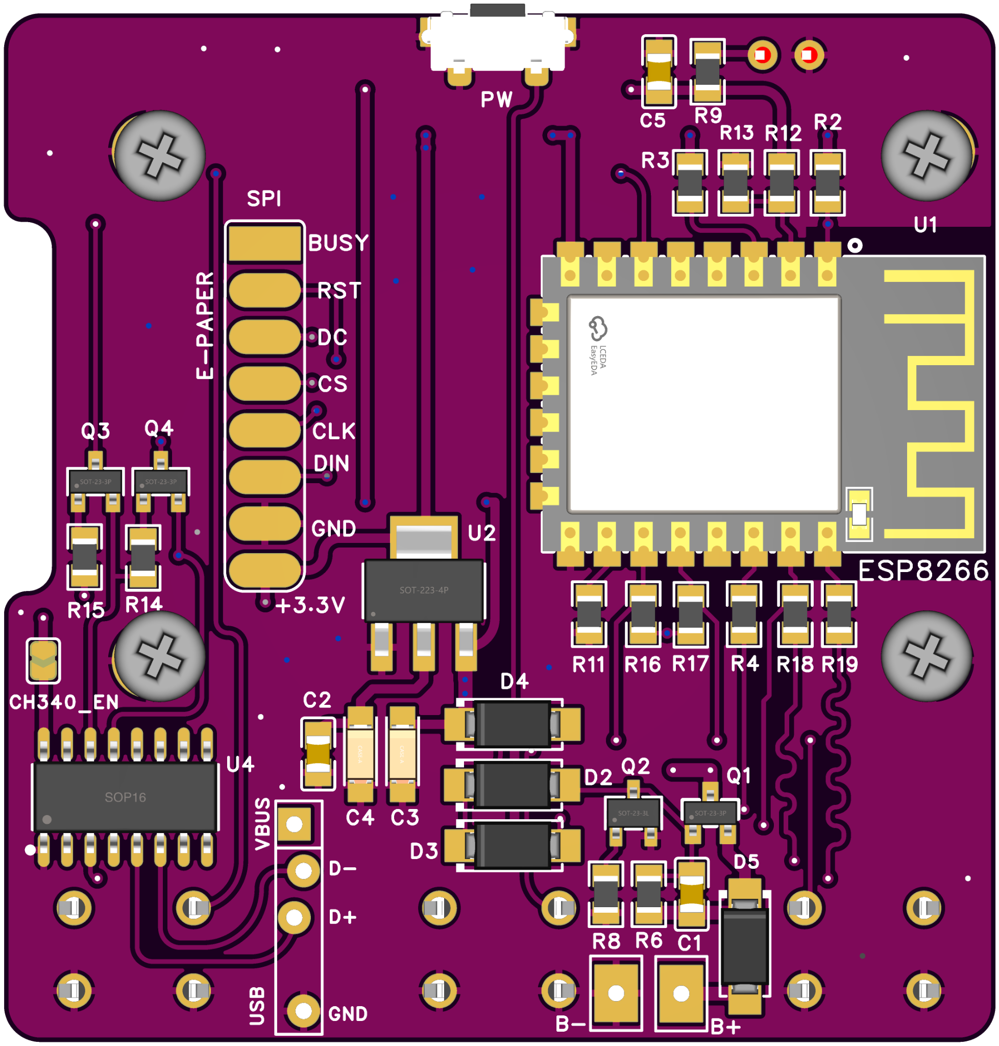
PCB

Slide 12
CONNECTIONS
E-paper display SPI wiring:
Busy - NC
RST - GPIO4 / D2
DC - GPIO16 / D0
CS - GPIO15 / D8
CLK - GPIO14 / D5
DIN - GPIO13 / D7
GND - GND
VCC - 3.3V
Buttons:
YES (left) - GPIO0 / D3
ABSTAIN (middle) - GPIO2 / D4
NO (right) - GPIO12 / D6
Power (Top) - GPIO3
ADC pin A0 for reading battery level
On/Off the power: GPIO5 / D1

Slide 13
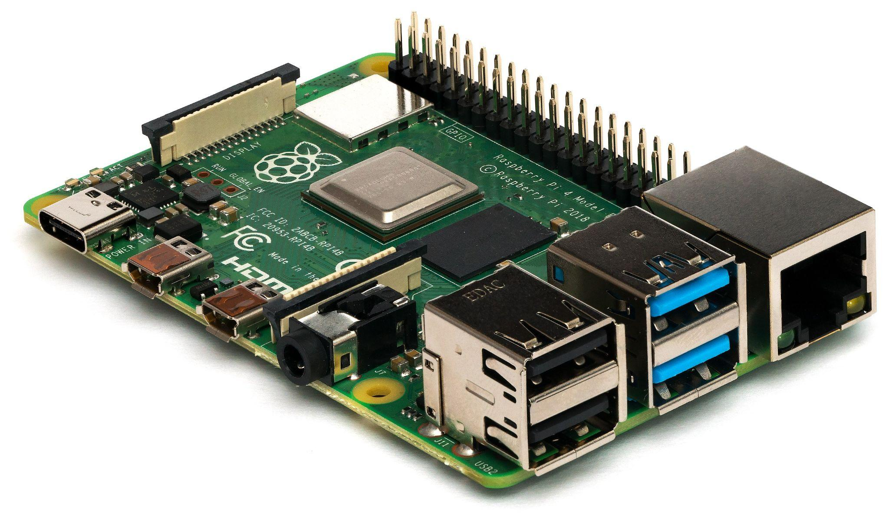
Server Programming
Raspberry Pi as the server hub.
Flask application for server-side logic.
MQTT for message handling between devices.
MySQL database for storing votes, ESP devices, and user information.

Slide 14
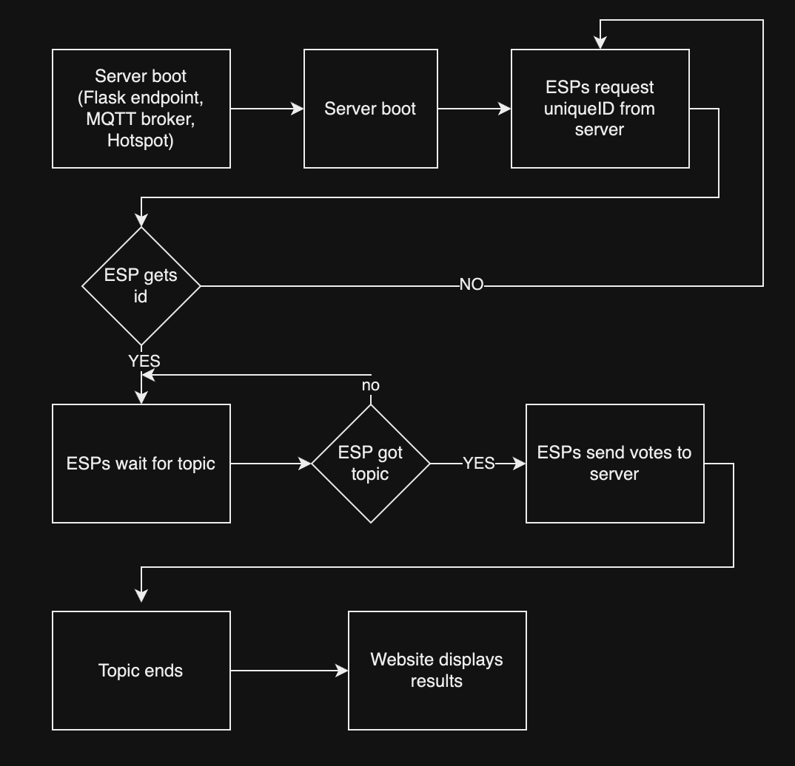
Server Programming System Interaction and Data Flow
ESP Device Registration and Assignment.
Topic Creation and Vote Management.
Real-time Voting and Results Display.

Slide 15
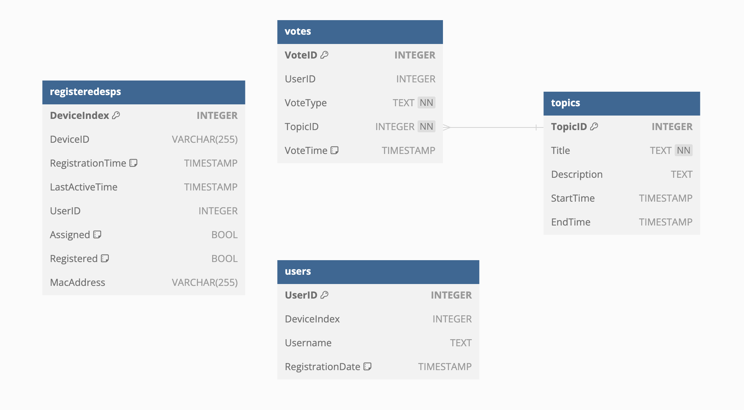
Server Programming Database Design
Flask-SQLAlchemy
Notes:
The database schema is designed to store information about ESP devices, users, voting topics, and individual votes. This structure supports the core functionalities of our voting system.

Slide 16
Hardware DEVELOPMENT
Team: Timo, Daniel
Case Design
Including electronic components
Securing Electronic Components
Accessibility to Buttons and Rechargeable Battery

Slide 17
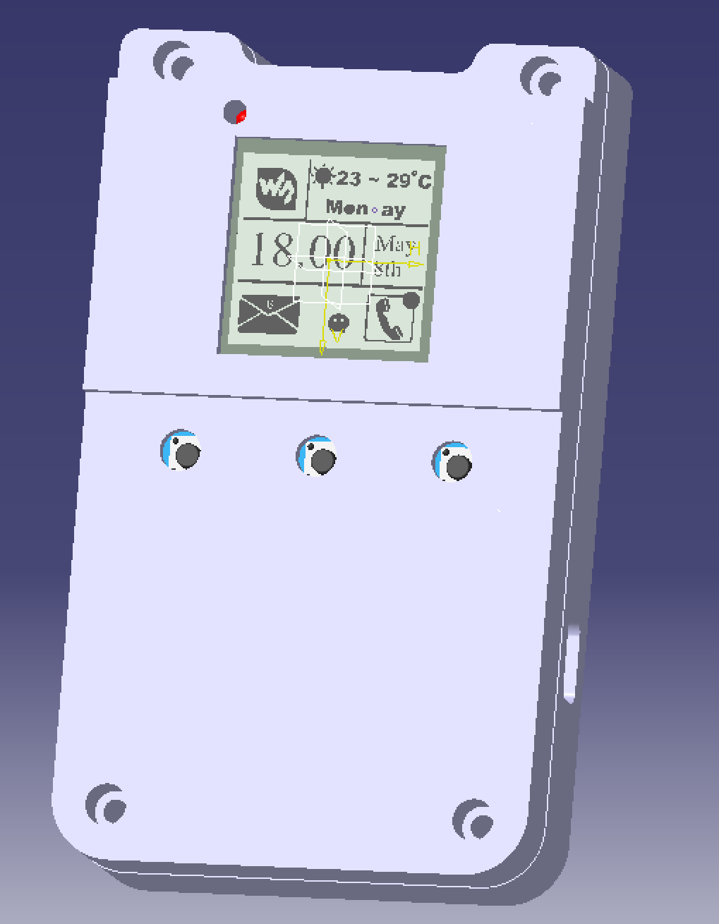
Design in Catia V5
Material: PLA Filament
Structure: Consists of two main parts
Components: Includes four buttons for user interaction

Slide 18
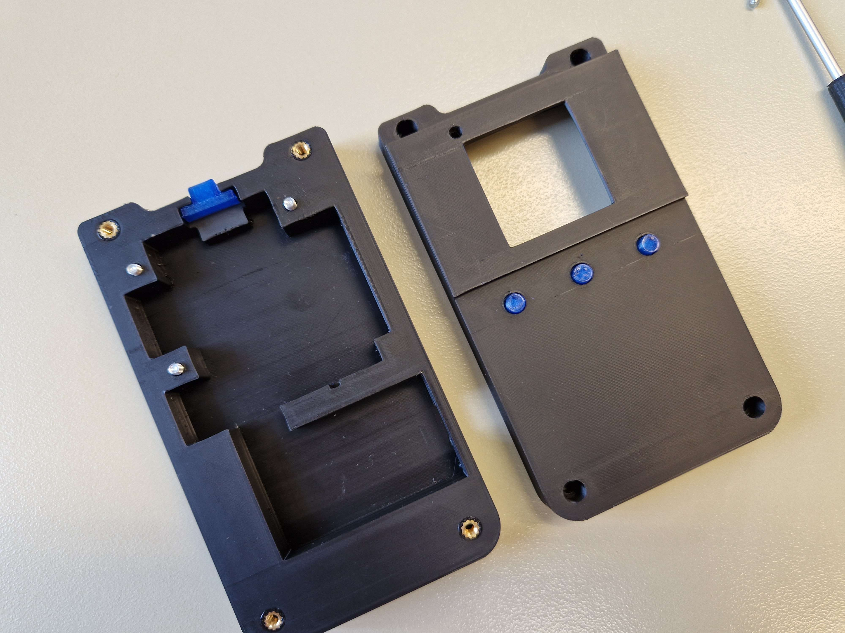
Printed Parts
Securing Electronic Components:
The enclosure is designed to securely hold electronic components in place.
Attachment via Screw Inserts:
Utilizes M3-Inbus screws for secure attachment.
Screw inserts integrated into the design ensure stability and durability.
Accessibility:
Ensures easy access to buttons for user interaction.
Facilitates accessibility to the rechargeable battery for recharging purposes.

Slide 19
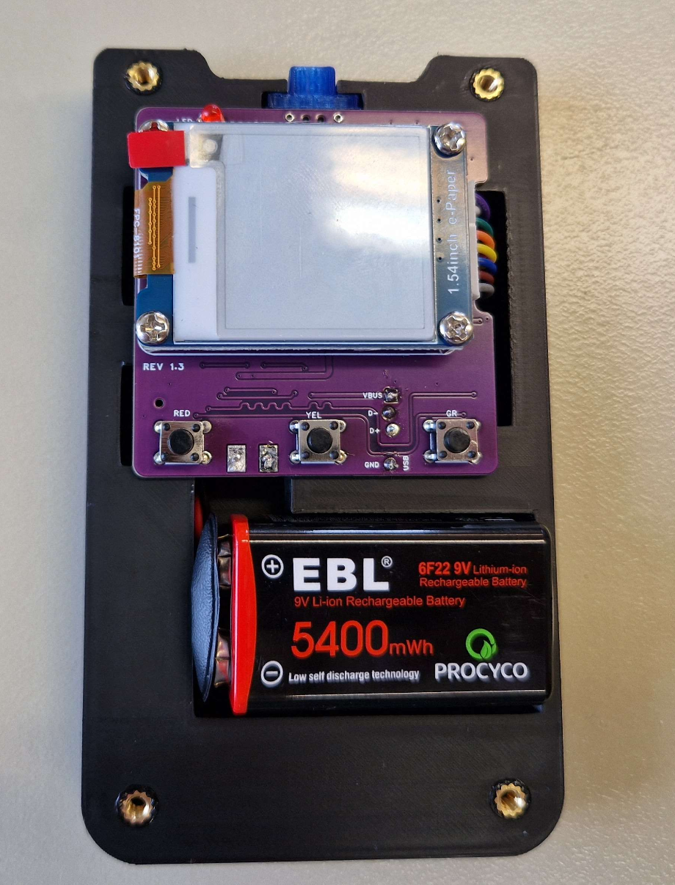
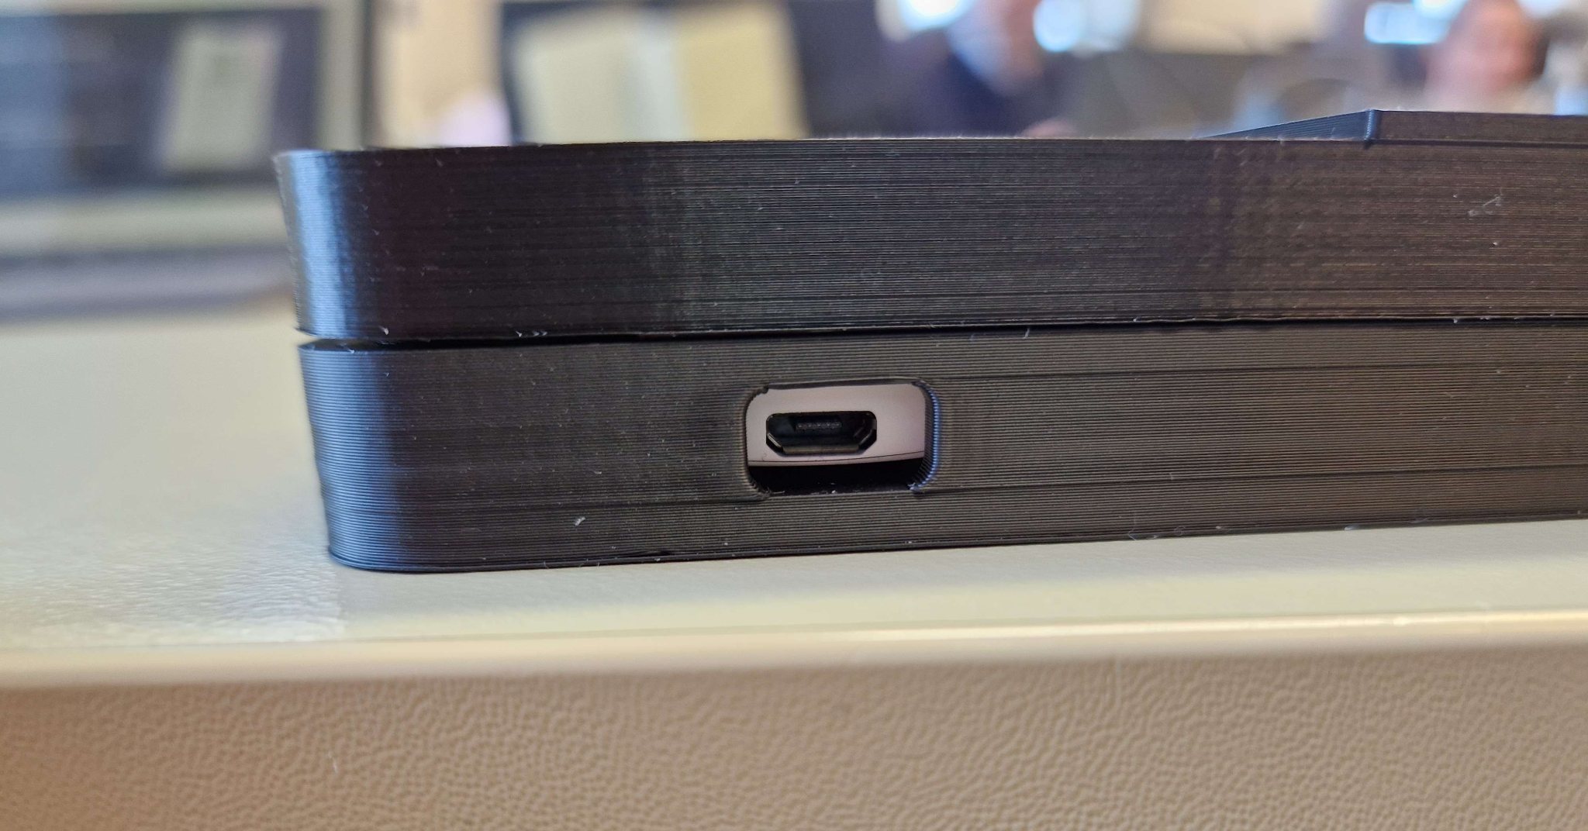
Securing electrical components

Slide 20
ESP & Display Programming
Team: Felix, Frank, Xuan, Nadim
Hardware
ESP-12F Wifi Module (Based on ESP8266) Custom Development Board
Clock frequency 80 MHz / 160 MHz
11 Programmable pins out of 32
Low cost, Low power consumed MCU
Hardware
Waveshare 1.54inch e-Paper Module
Resolution 200 x 200
Full refresh time 2s
Interface 3 pin / 4 pin SPI
Refresh power 26.4mW(typ.)
Standby power <0.017mW

Slide 21
ESP & Display Programming
Team: Felix, Frank, Xuan, Nadim
Tools & Technology
Arduino IDE
SPI Communication Protocol (Simplex - Data flows only one direction)
C / C++ ( Arduino sketches)
MQTT messaging protocol

Slide 22
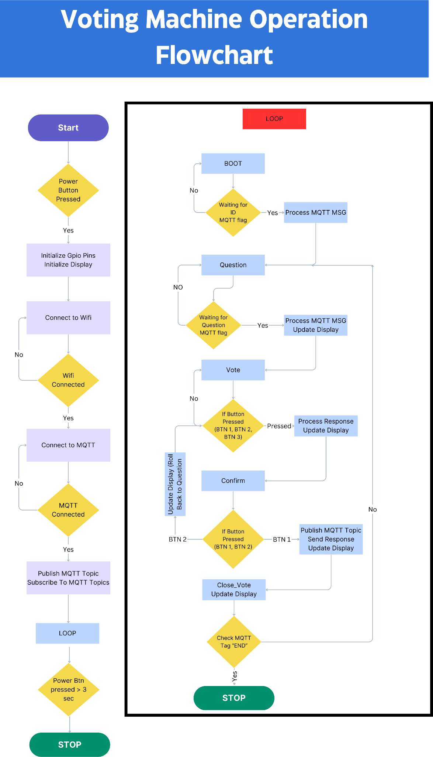
ESP & Display Programming

Slide 23
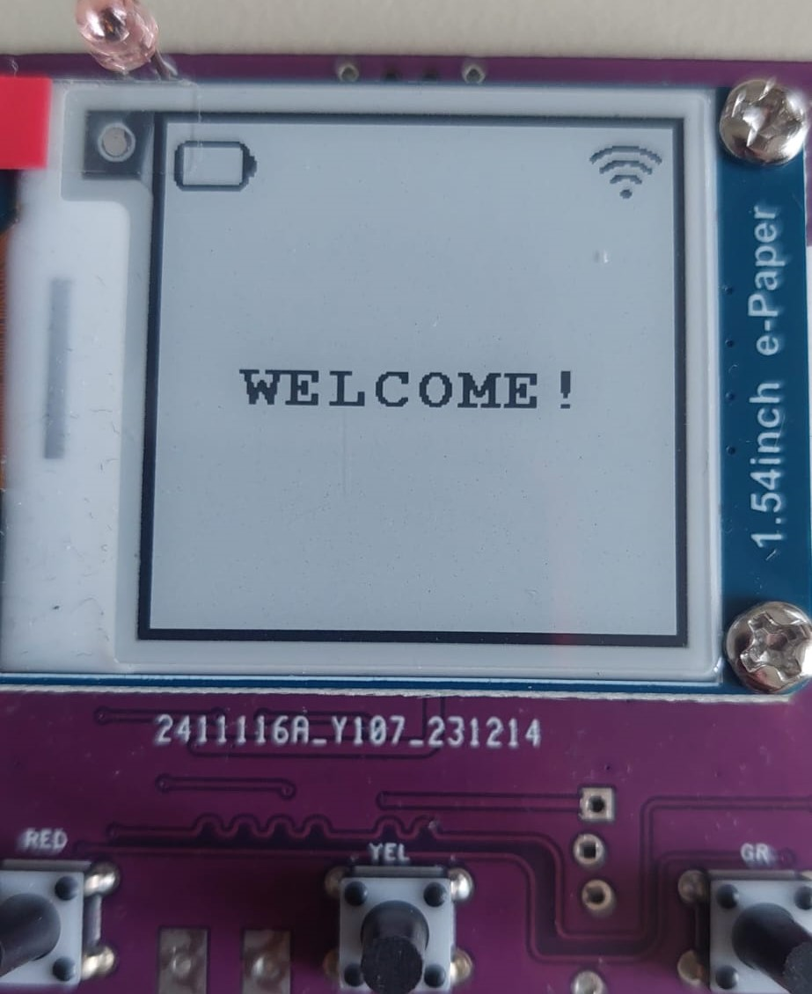
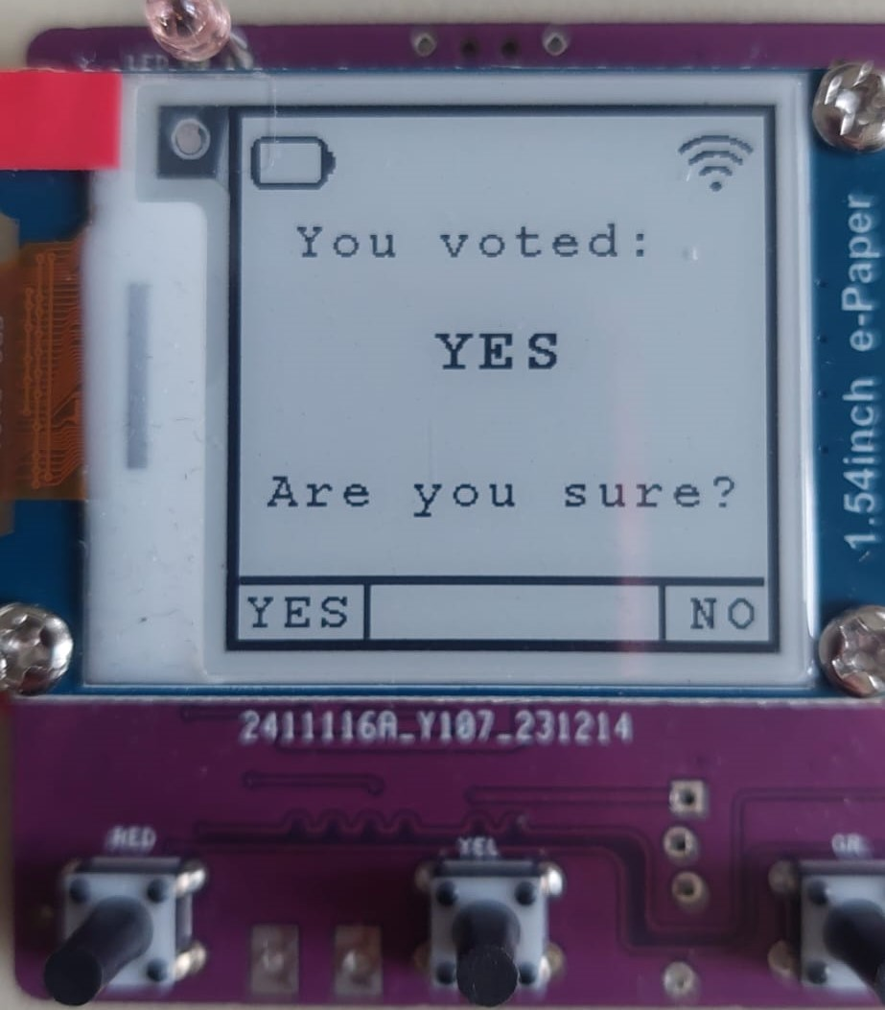
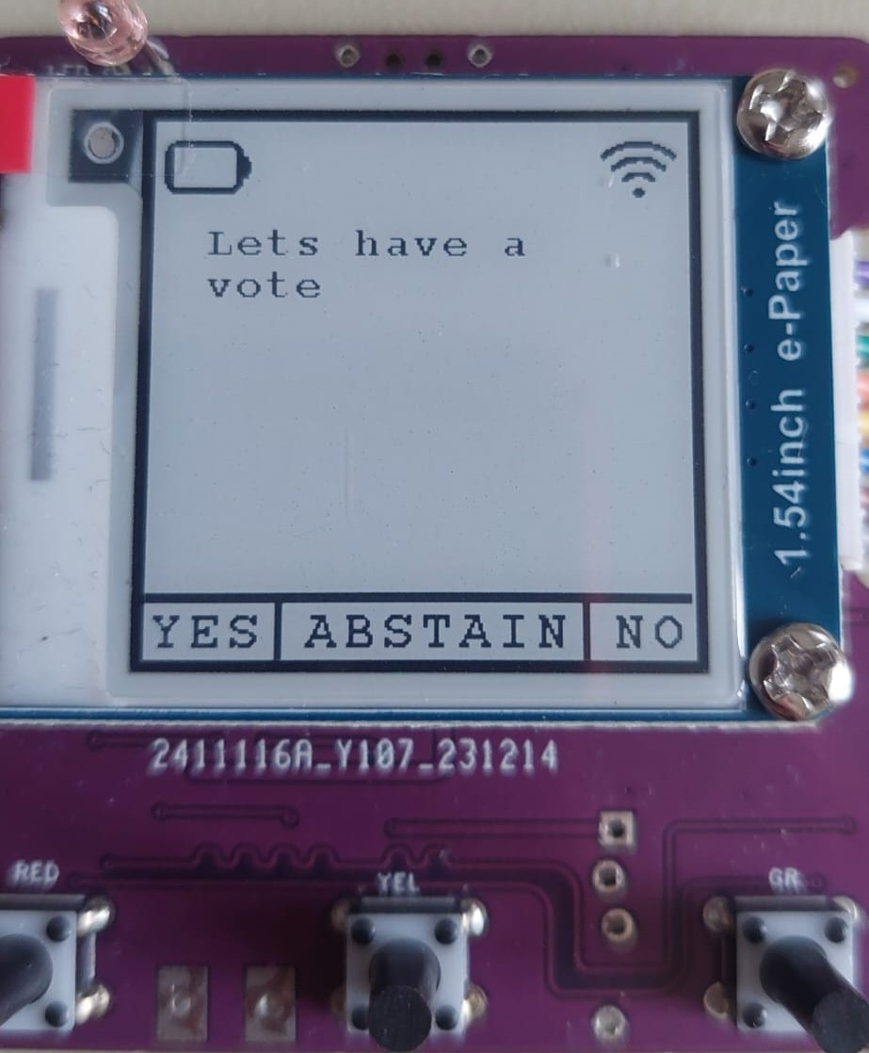
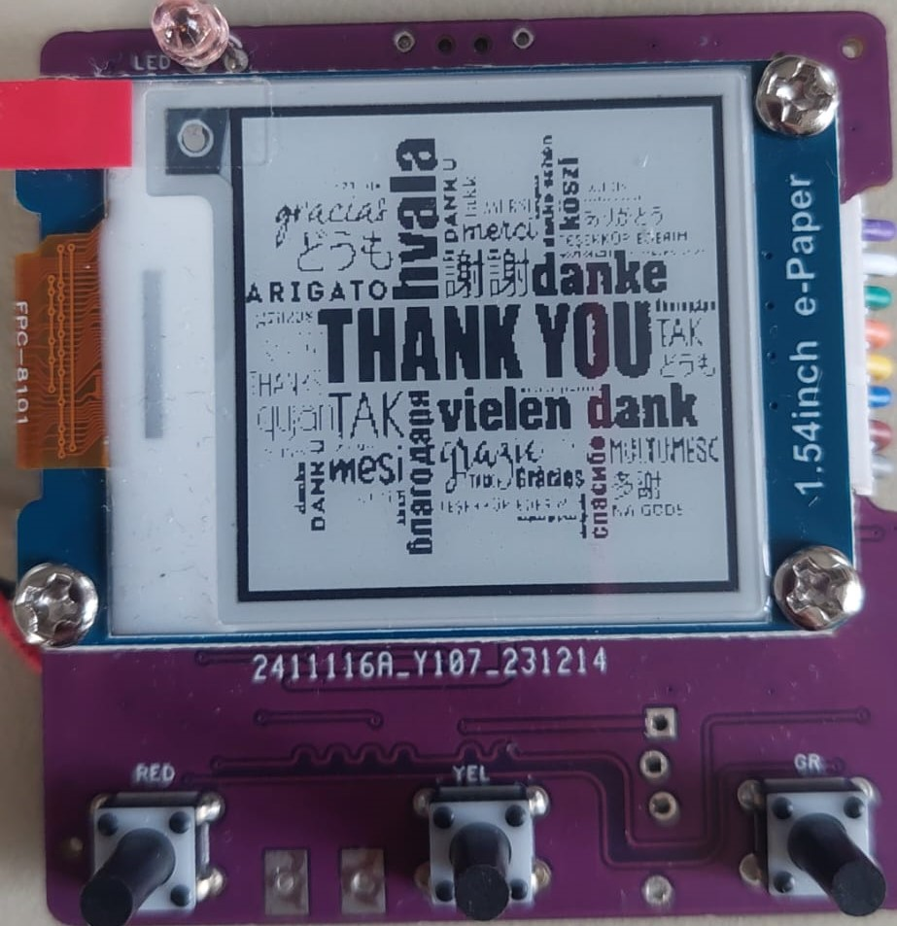
ESP & Display Programming
Team: Felix, Frank, Xuan, Nadim

Slide 24

Thank you!

